Slide 1
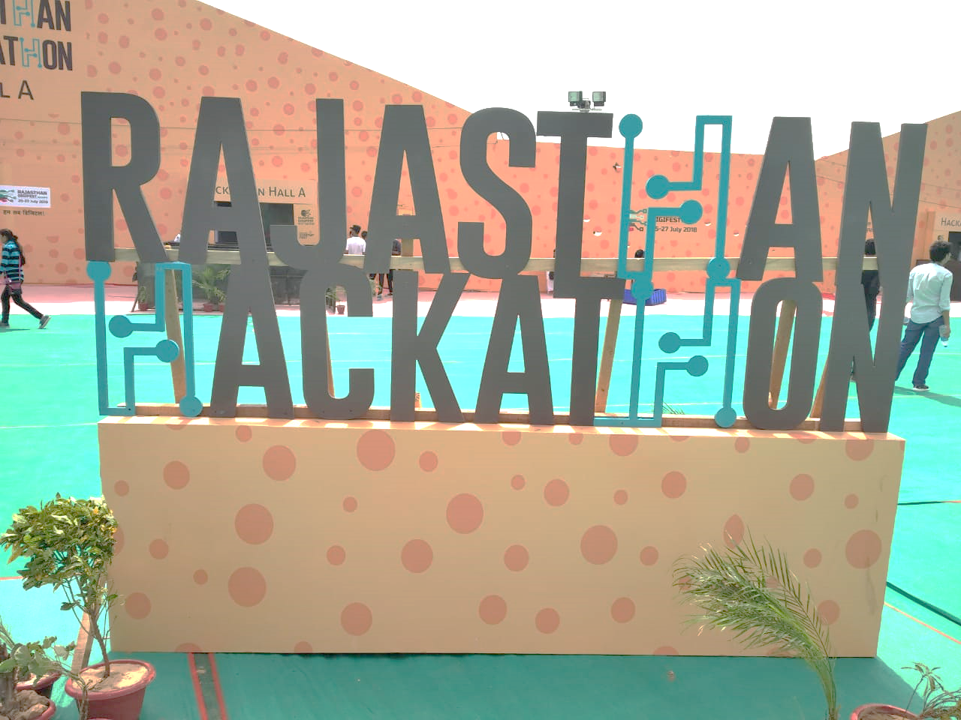

TEAM:
TEAM ID:
TEAM MEMBERS:
AJAX(GREEN-A-THON)
2919(GREEN-A-THON)
Rohan Mujoo , Yash Chauhan
Sahil Soni , Mohit Jain
Notes:
NaOH and Hot water regeneration for small scale industries. Thermal regeneration for large scale industries.(For activated Charcoal)

Slide 2

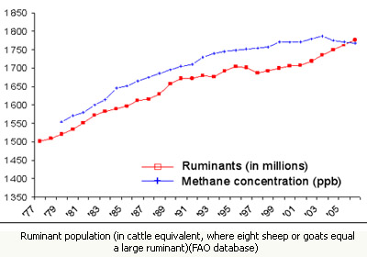
INTRODUCTION
We (Team Ajax) wanted to come up with an innovative and completely new idea to tackle the age old problem of global warming.
After doing extensive research on our part we came to know that ruminating animals like buffalos actually are a leading cause of pollution in todays time.
Trying to dig into the topic further we found that there has been no work done in this field to actually help reduce this pollution being caused by ruminating animals.
The emission of methane has increased ten folds since 2006.
So, we decided to do something about it ourselves and came up with the idea of “RUMINANT GAS PURIFIER”.

Slide 3
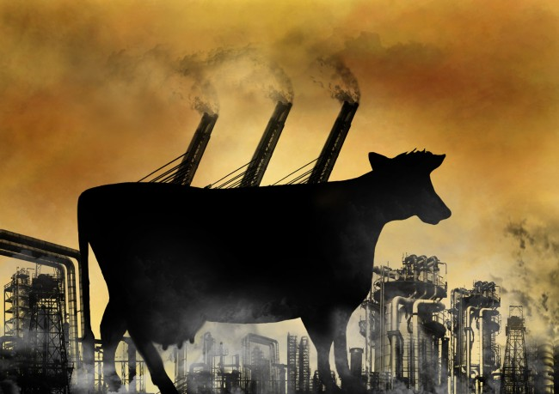
RUMINANT GAS PURIFIER
NOTE:
For purpose of practicality We will be calibrating our product(just for the competition) with deo instead of methane, as methane is not easily available and is harmful(poisonous)and also hard to handle.

Slide 4
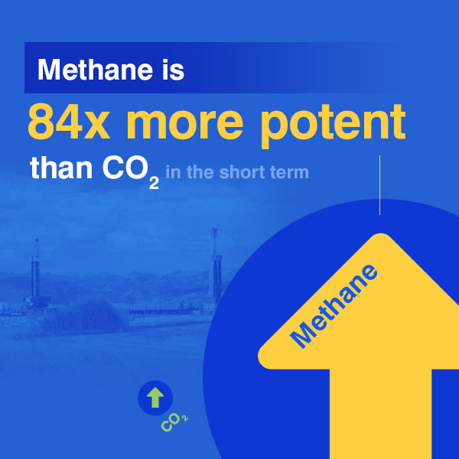
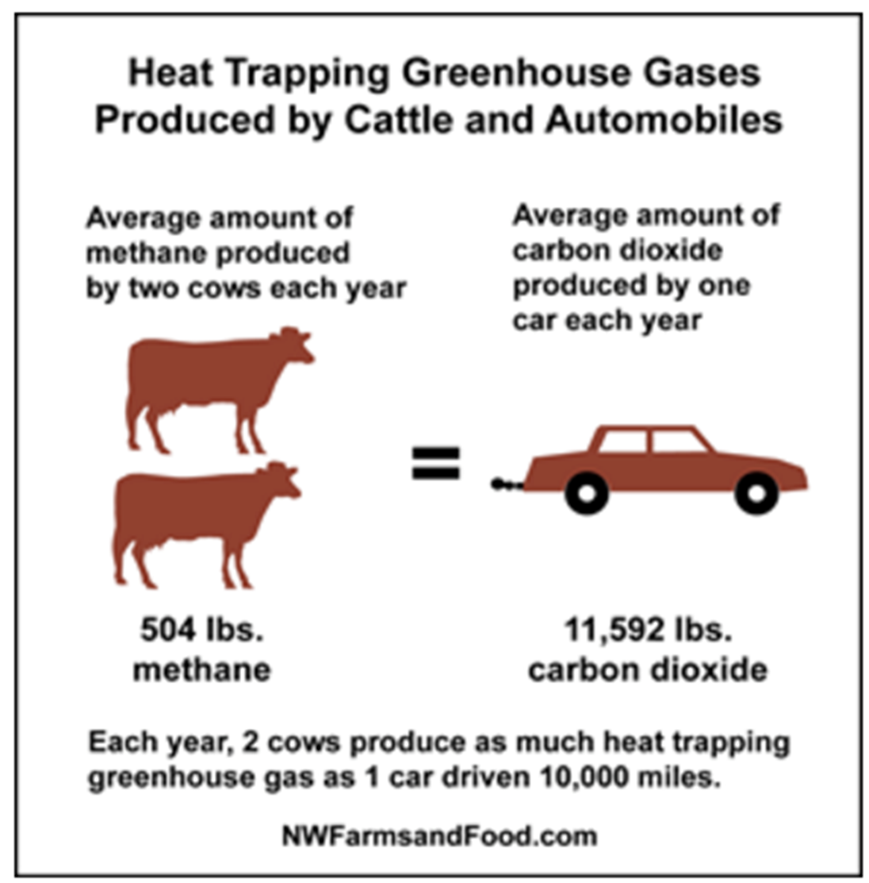
Believe it or not, Grazing animals have become one of the biggest cause of Global Warming.
Our project aims to tackle this problem at its heart without harming the animals in question.

Slide 5
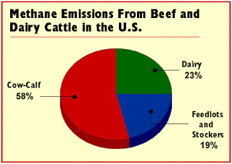
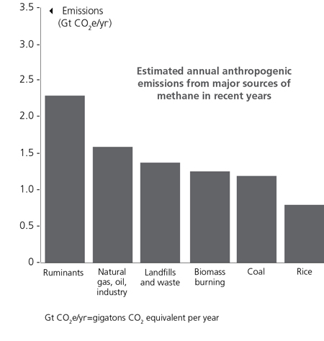
Affected Community
The affected community in our case is humanity as whole, As we are trying to fend off ‘Global Warming’ through our idea.
Brief History of Idea
(How long are you working on this idea and why?)
We came up with this idea whilst brainstorming and working on a completely different idea.
The idea previously was to make a pollution control kit but it seemed to be impractical due to cost and variety of components required, so we modified it to something that can be practical and even economically feasible.
Our project/idea is unique and still in development, even after hackathon we intend to add some more features to it, that we can’t as of now because of the rules and limitations enforced by the green a thon event.
We are working on this idea because we strongly believe it can help us undo some of the damage we humans have caused to our mother nature.

Slide 6

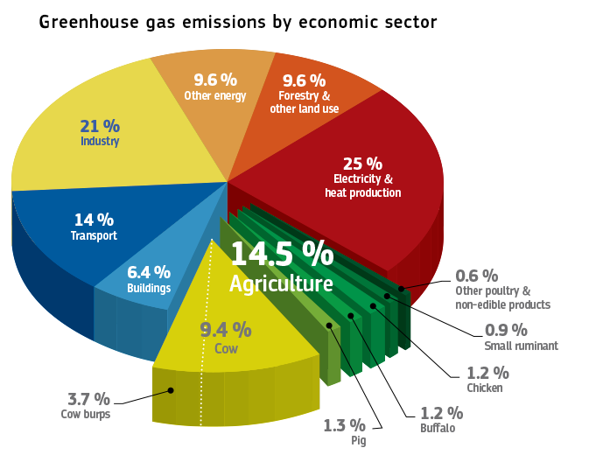
Originality And Other Aspects
(Whether the idea is original or derived from some established technology or process?)
The idea itself is original but the methods being used to carry out the idea are established and well known processes. For eg: Use of Activated Charcoal For Filtration.
(Whether the solution is state of the art or conventional)
I feel this project is an amazing combination of a sate of the art idea using conventional methods. We are using a completely new idea that we came up with ourselves and are using conventional technologies like activated carbon filter, vacuum via fans etc.
Ruminating animals produce more harmful greenhouse gases compared to vehicles but no one seems to care, thus we came up with the idea to make something to keep methane emissions from ruminating animals in check
Till now govt has only come up with policies that stop pollution coming from vehicles but we feel the problem of methane emission has gone unnoticed

Slide 7
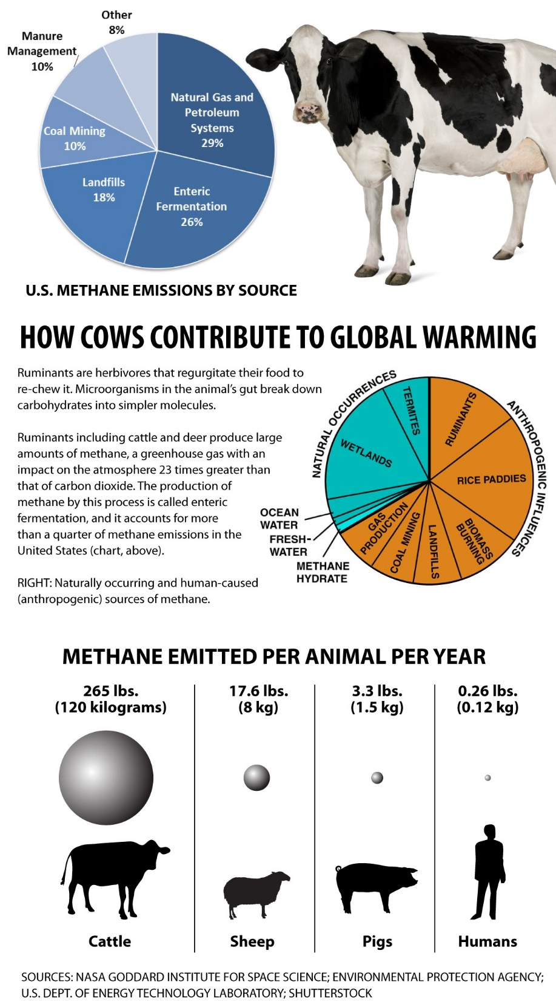
OUR IDEA
The idea is basically our attempt to reduce global warming.
As shocking as it might sound, Grazing animals can produce huge amounts of methane in a single day. As good as methane is as a fuel, it simply isn’t good for our environment if left to escape out in the open.
The project we are working on now aims to trap as many impurities as possible that are produced from a grazing animal flatulating(passing gas).
Our product is a cost efficient apparatus, that’ll be placed on the back of grazing animal.
The prototype we are developing as of now, Isn’t exactly what we dreamed our product to be like. The rules and restrictions of the event won’t allow us to make the product in its entirety.

Slide 8
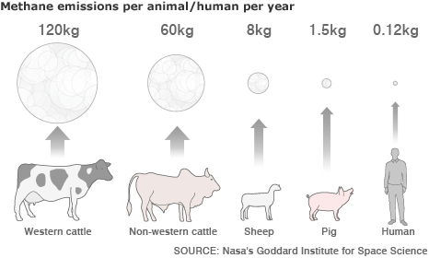
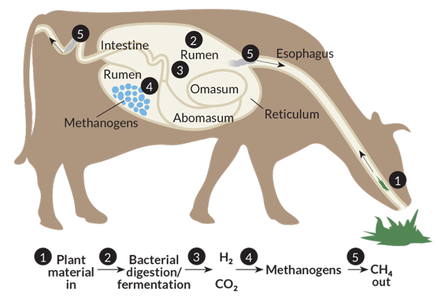
Working
The flatulence(gas) of Ruminating animals would be sucked into the apparatus/product.
It’ll be made to pass through Activated Carbon Filter.
The impurities would be adsorbed by the activated carbon filter.
Thus storing the all the impurities within our filter before they escape into the environment.
With the resources we have we can’t guarantee the efficiency to be a lot, but in future we plan to add a pressurized tank that could store methane which can be used by us humans for our own purpose.

Slide 9
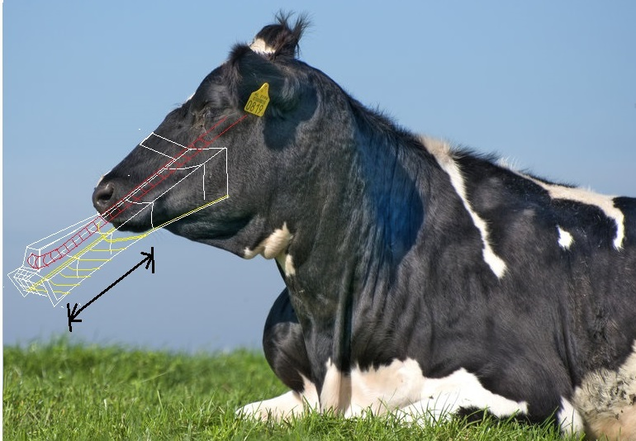

$$x$$
FIG 1: Illustration of how the mask would look like.

Slide 10
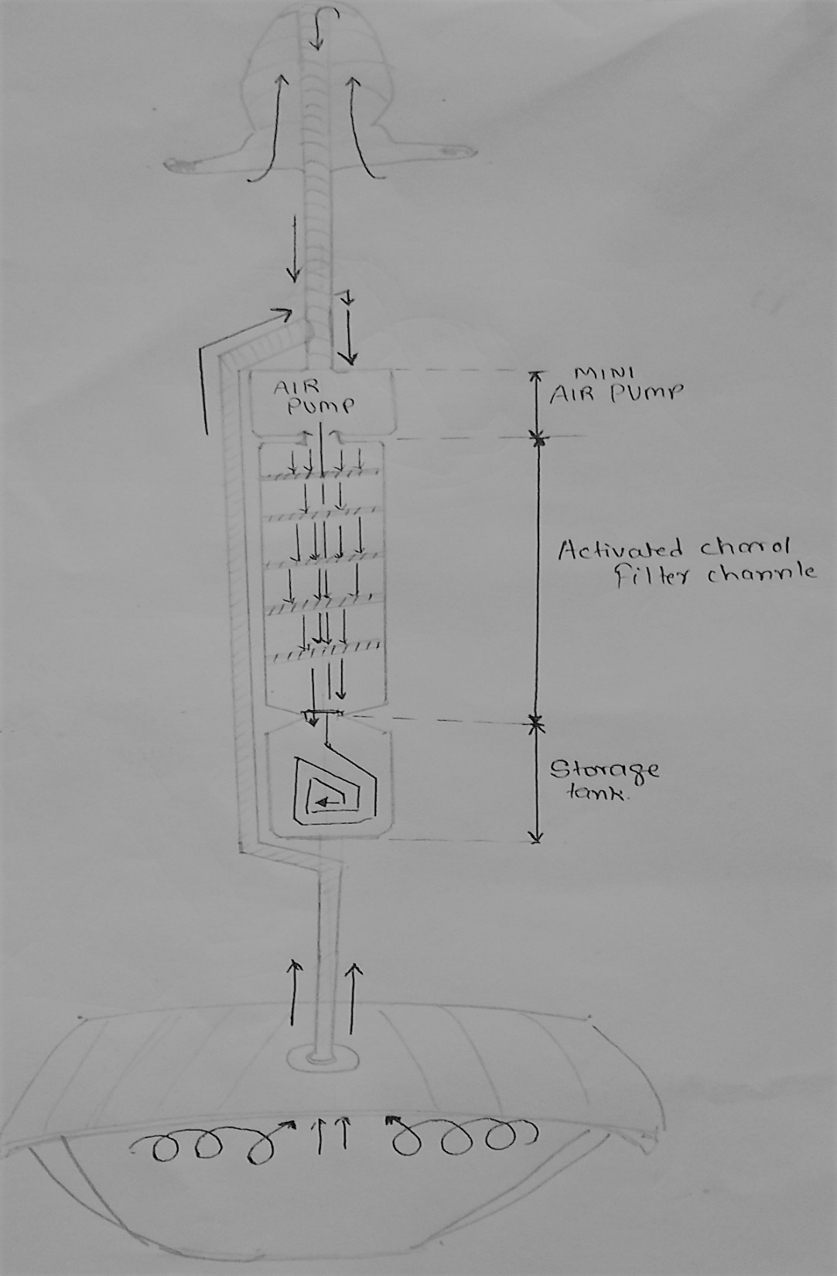
Mask
Air Channel
Air Pump
Activated Carbon Filter
Part of apparatus for Posterior
Incoming Methane mixed with gas

Slide 11
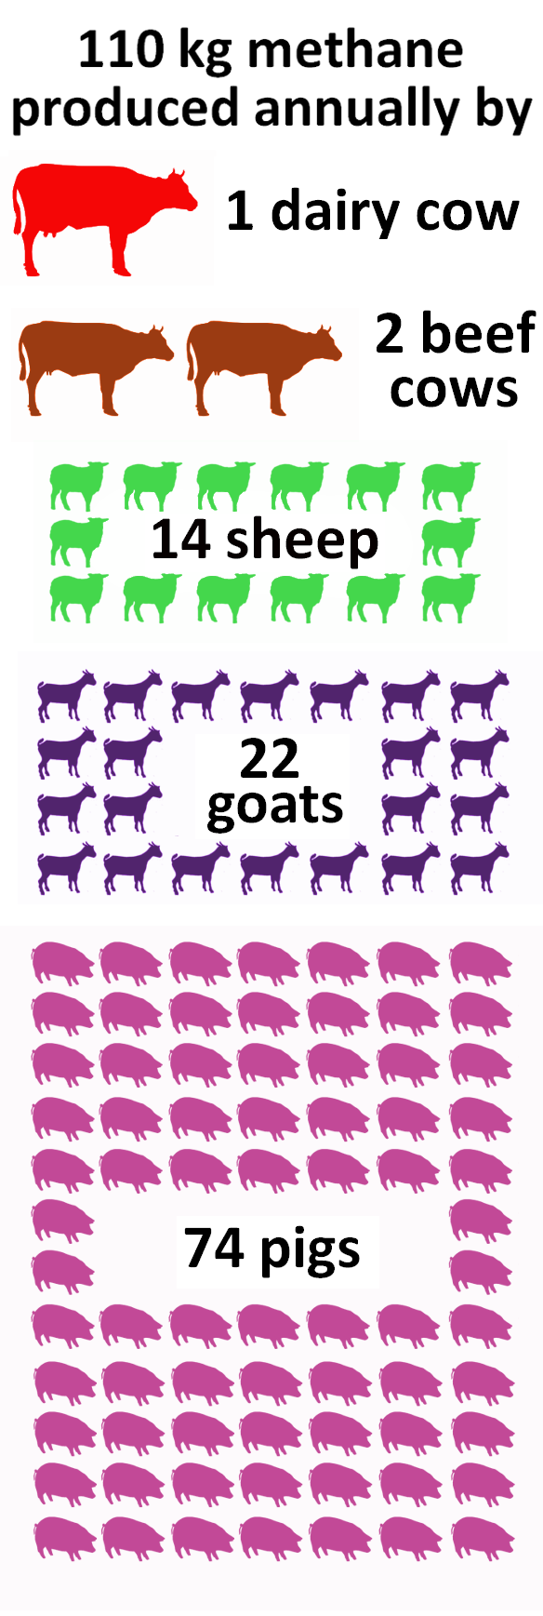
Details
Concept
The idea is basically our attempt to reduce global warming by making an apparatus that uses activated charcoal filters as a mean of purifying the flatulence(gas) of Ruminating animals.
Method
We create vacuum using air pump that causes suction which will help us absorb all the flatulating gasses coming out of the Ruminating animals.
This absorbed gas would then undergo, through the process of adsorption of impurities.
Feasibility
The product is easy to use. To use it all you have to do is put the product on the back of the animals. It also is cost efficient and the activated carbon filters are easily removable and replaceable.

Slide 12
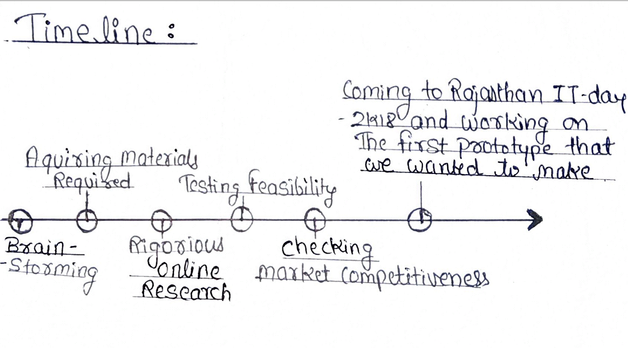
Implementation
First step would be to supply our products to milk farms which have lot of grazing animals via means of some sort of subsidy.
This’ll involve contacting all huge dairy farms, to get the word about our product going. Due to having less experience with management in real time, We plan to use online media campaigns to gain momentum for our project marketing.
TIMELINE OF OUR WORK:
Arranging Necessary Materials
Working Out On The Underlying Issues
Attending The Event To Exhibit Our Project
Rigorous
Conceiving The Idea
Extensive
Research
Development & Rectification of Issues

Slide 13
Challenges
The biggest challenge we feel is that our product being totally new to the market won’t be easily accepted by consumers unless marketed properly. Because, all consumers would have their own doubts regarding their pet’s safety and might be reluctant at first.
For fruition our product requires support of the government and getting that support would be a huge challenge as well.(As our customers are the people who own cattle and heard stocks in huge amount i.e. dairy owners and farmers)
Revenue and Time required to work on this project full time.
Revenue Model
For the revenue model we are looking forward to take help from the startup incubation center started by the Rajasthan govt called ‘Start-Up Oasis’.
This is a wonderful initiative taken by the Rajasthan Govt which helps budding entrepreneurs such as us to showcase our talent by providing legal and business related advices.
We, have no shame in admitting that we have very little knowledge about what the revenue model will be like and would completely dependent on start up oasis for help and advice. But we’ll make sure to not slack off and work hard to learn as well.

Slide 14
Feasible
S
W
O
T
(Strength)
(Weaknesses)
(Opportunities)
(Threats)
Cost Efficient
A totally new concept that’s completely alien to the population
It’s a 2 in 1 product thus has caliber to establish a new exchange between govt and farmers.
Being an obscure product might result it in being shunned at first
It’s a walking air
purifier
Size
Once out in market there’ll be new emerging competition

Slide 15
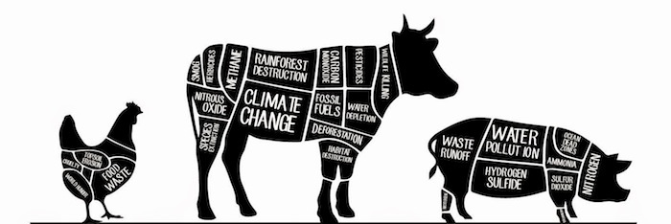
Probable Outcomes
As we have mentioned earlier, for the outcomes to be positive we’ll be heavily depending upon government support due to the target(consumers) of our product. If things go our way, we hope that this product will become a necessity instead of a commodity.
If things don’t go our way, and conditions become unfavorable, we’d have to introduce some changes (eg: size) for it to meet are earlier requirements.
Future Aspects
The future aspects can be broadly divided into 2 categories 1.) It becoming a full fledged project. 2.) It being outshone by some other, better idea/concept.
This being something completely new puts us in an uncertain position regarding it’s future as we have nothing to compare this with in the market. Thus we feel this project can be a major success with right guidance provided to us by the government and our mentors.

Slide 16
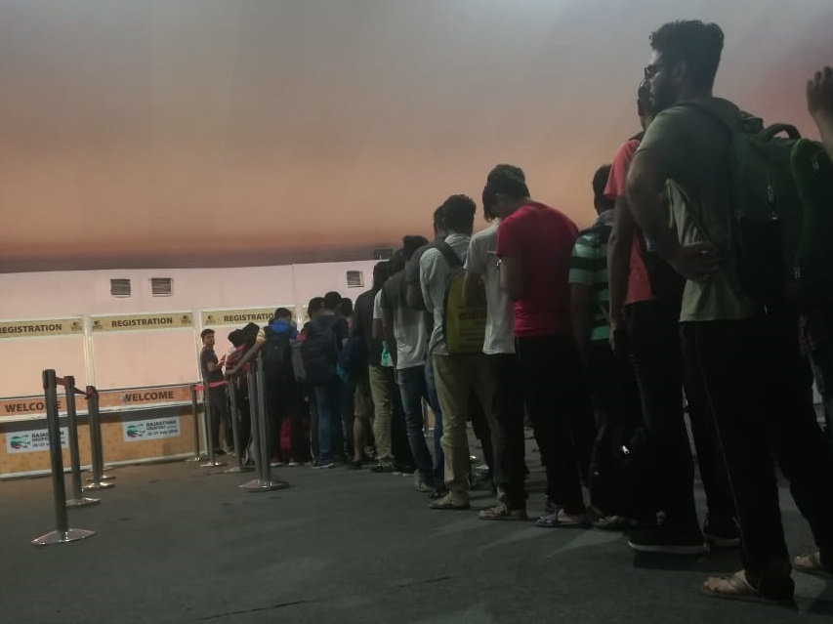
THANK YOU
FOR HAVING US

